Slide 1


How I Made My C++ Project
Authored By: Jeremy Whitenect

Slide 2
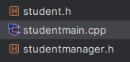
Thought Process
As I looked over the requirements, I understood what I had to do, the biggest question was how to do it
It was obvious to me that there would need to be a student class, and since we were required to add and remove students, I knew there would also need to be a manager sort of class
Since we knew we’d only be using 3 grades, I opted to have them be separate instead of being their own array
Finally, the only thing I wasn’t decided on at first was if I was going to have the grade weights be in their own class, but since they’re part of “managing” a student, I decided they could go and be changed in that class

Slide 3
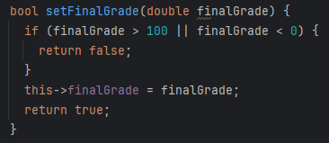
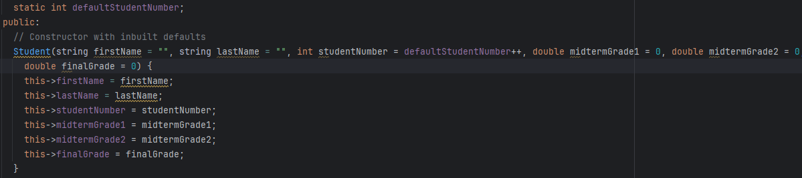
The Student Class
This was the easiest and simplest class, being just setters, getters a toString and a constructor.
There were still interesting aspect to this, though. The grade set methods are Booleans
This is because a grade can’t be negative or over 100, and I wanted to have a way to let the user know if the method worked
There is also a static default student number since we want student’s ids to be unique
The StudentManager class handles creating students, so this is only needed so the id changes when using the default constructor values

Slide 4

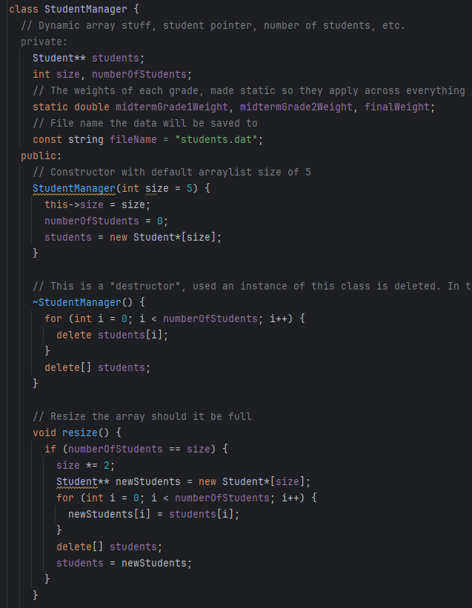
The Student Manager Class – Dynamically Allocated Array
Dynamically allocating an array is different from Java, as we have to do some things manually.
I used a pointer to pointer array, meaning each pointer is a points to a pointer which points to the data.
I decided to do things this way to challenge myself a bit, and see how it would compare to a normal array of pointers (which I used for the final project of our C course)
Adding data is basically the same, we have to have a separate size, increasing it when the array is full, and we have to have the current number of students separately as well
I also have a destructor which is called when the object is destroyed. In this case, it deletes all the students and the array to prevent memory issues

Slide 5
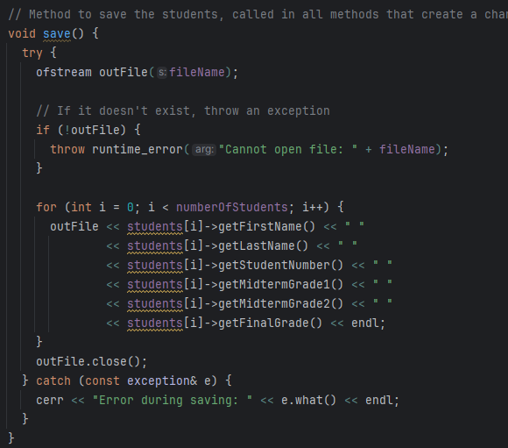
The Student Manager Class – Saving to a File
Since file input/output was mentioned in the rubric, this is how I decided to implement it
This does NOT save the values for the grading scheme, as I’ve made the values for the grading scheme static, meaning the values stay the same across all instances of the StudentManager class
I did it this way because I figured all students should have their work weighted the same, even across StudentManagers

Slide 6
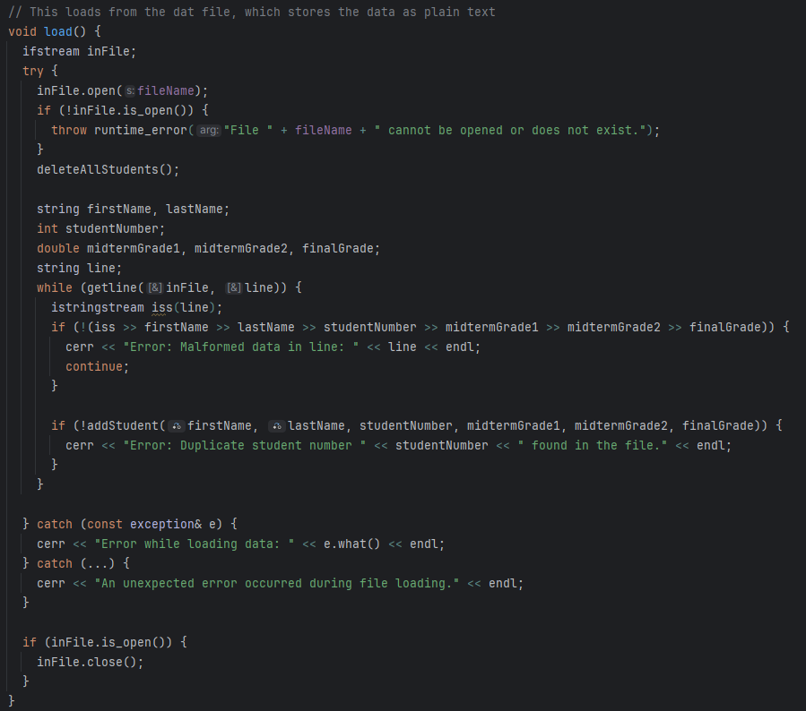
The Student Manager Class – Loading From A File
Loading is much the same, but in reverse
There is an extra check to make sure the data is in the proper format so it can be loaded
Other than that, very similar to saving.

Slide 7
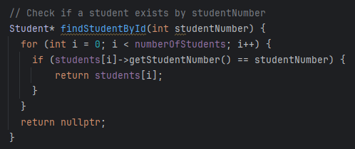
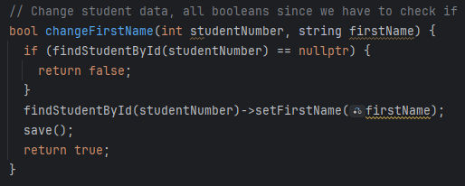
Getting Student Data From The Array
Since a student number is unique, every time we want to get or change a student, we want to find it by student number
The findStudentById method is used to get a specific student. If the student is exists, it’s returned. If not, a nullptr is returned (since we’re using a pointer to pointer array).
By extension, it can be used to check if a student exists, not single responsibility but no issues arise from this since I’m using “nullptr” as something equivalent to studentExists = false;
Whenever a student needs to be modified, we check if it even exists in the first place
If (findStudentById(studentNumber) == nullptr) could have been a separate method, but it barely saves any lines of codes, so there’s a check for every change method
On a much, much, much larger scale it would save some compile time and memory, but not on this scale

Slide 8
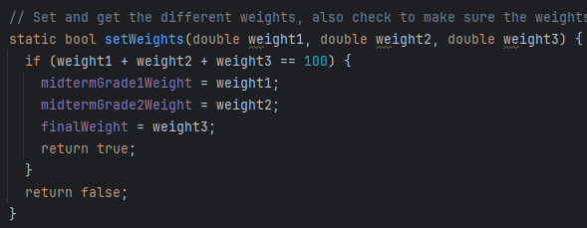
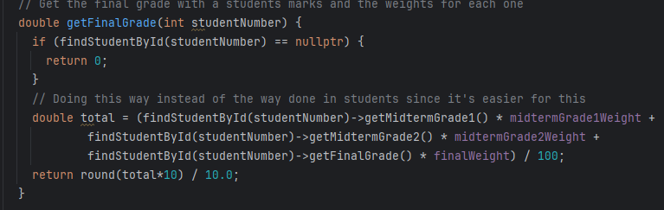
The Weighting
The weights are set at 25, 25, and 50 at default (which are initialized at the top of the class, and then set at the bottom)
Method is a bool as well since they have to be very specific, all summing to 100
Technically they should sum to 1, but 100 is easier to work with, so we just divide by 100 when returning the final grade
Since we’re getting the grade for a specific student, we also use a student number, returning 0 if they don’t exist, since a student who doesn’t exist would have a final grade of 0
Null would also work, but this is just the way I decided to do it, no wrong or right

Slide 9
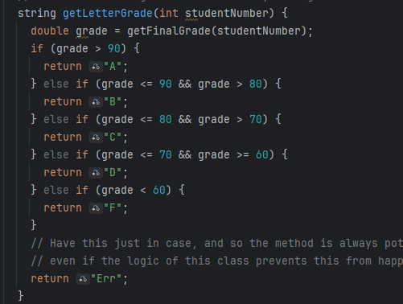
Getting A Letter Grade
Takes the final grade of a student using its id and that method
Then checks if the final grade is in certain ranges for certain letter grades
Technically I didn’t have to use the else ifs since return ends the method, but it reads a bit easier this way
Logically, it should never return “Err” but it’s there since it has to be for the method to work, and good to have since should doesn’t mean can’t

Slide 10
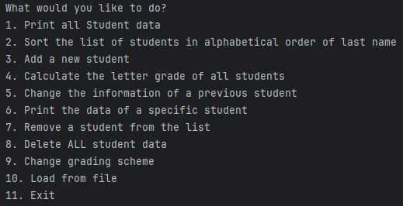
The Menu/Conclusion
The menu simply runs the methods based on the user’s option, nothing fancy
All in a while loop, 10 breaks the loop, the only thing outside of the loop is return 0, so the program ends
Overall, I had a good bit of fun doing this project
I always have fun using ArrayLists, so the extra challenge of C++’s equivalent and allocating memory made that a bit more fun.

